Slide 1
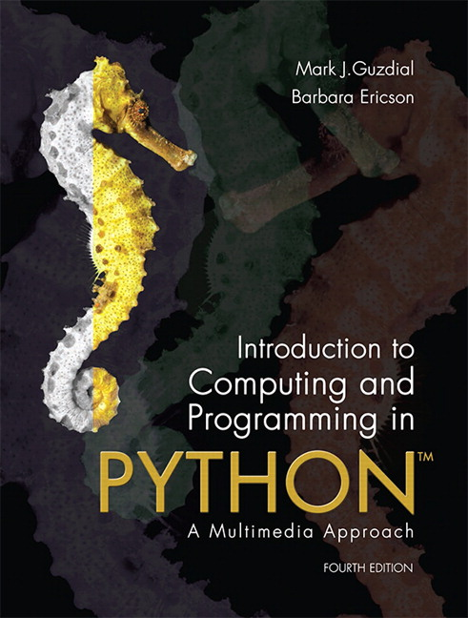
CSE 8A – Introduction to Programming and Computational Problem Solving I
CS1-LLMs Materials © 2023 by Leo Porter, Dan Zingaro, Beth Simon, and Christine Alvarado is licensed under CC BY-NC-SA 4.0
Introduction to Image Processing
How to get help:
Class Website
https://sites.google.com/ucsd.edu/cse8afa23/home
Piazza for brief questions or logistic questions
Tutor Hours for help with homework/setting up computer To get help, use Autograder (directions on piazza)
Office Hours for homework/conceptual help
Slides based, in part, on materials from Dan Zingaro, Beth Simon, and Christine Alvarado.
Notes:
Welcome!

Slide 2
Announcements
Survey due next Tuesday at noon
Link on piazza and canvas
Please give us your candid feedback!
both positive and negative
Homework 6 due Monday at 10pm
Quiz 3 in lab next week
Project 1 – Full version due Tonight
Have fun! Copilot strongly recommended.
Project 2 – Images
Releasing later today/tomorrow
Tomorrow is a holiday (no discussion, reduced lab/OH)

Slide 3
Question
Lecture on Tuesday of Thanksgiving week.
Two options:
Online via zoom at regularly scheduled section times, we’ll do breakout rooms for discussion and use the poll feature for voting.
Video recording of the lecture where I’ll pause at each question to give you an opportunity to think on your own, then continue with the answer.

Slide 4
Go farther with Markov Text Generation!
Context is a single word, but if you make it multiple words, it’ll get better. (But too many words of context just repeats the source, so find a balance.)
Could use average/median list length as a measure of variation
Whenever we run out of words, let’s start with the first word in the source.
Next step, rather than starting with the first word in the source file, could we randomly pick a different word?
Randomly pick a key from the dictionary?
Advanced, keep trying until you find a capitalized word at the start of the sentence, then run with that.
Notes:
You all have different personal experiences. I can’t adjudicate fairness in the world and the playing field is never level. Remember that we all have our own personal struggles and do your best.

Slide 5
Project 2
Create a photo collage/image of your choosing
Use at least 3 source images
Use at least 4 functions
No use of outside tools (photoshop etc.)
Only use the built-in functions in PIL that we learn in class today
Opening, showing, writing files.
Size of the image
Reading and writing of each pixel

Slide 6
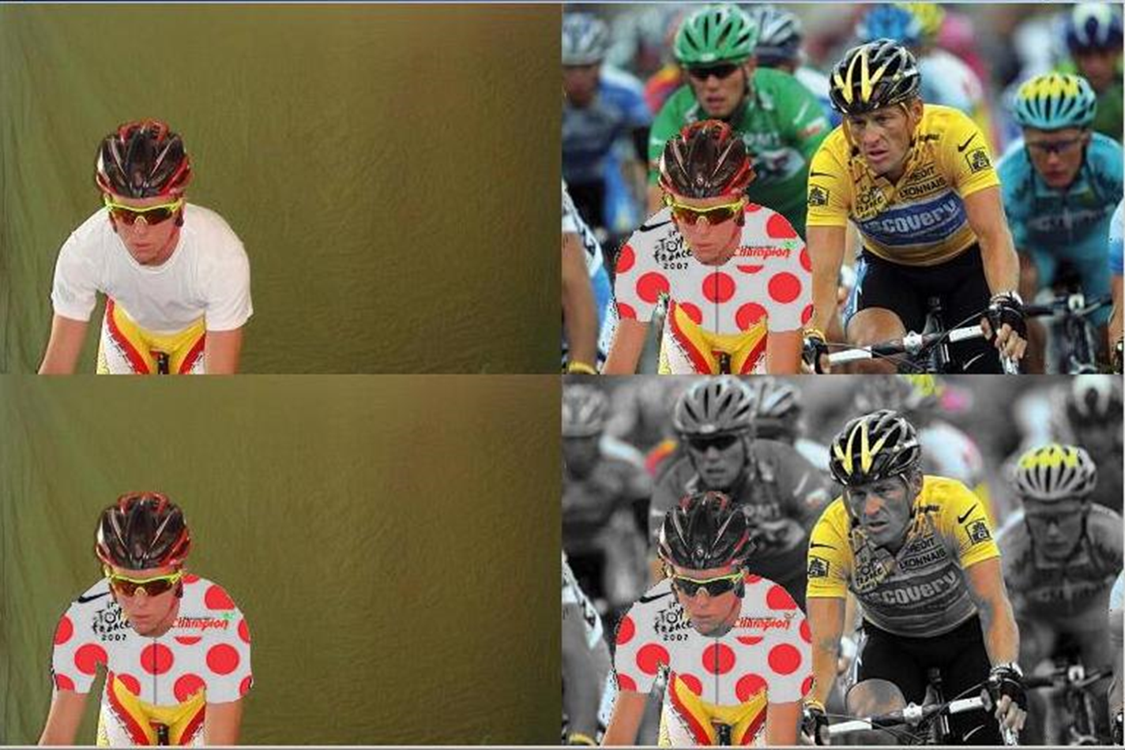
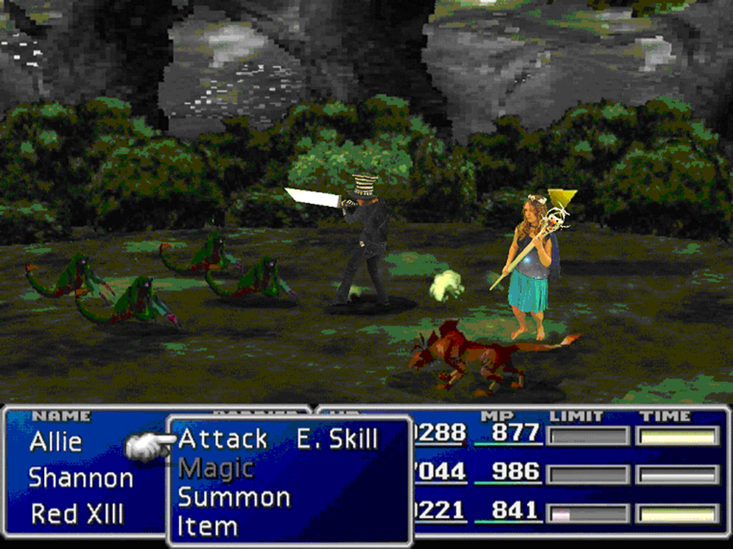
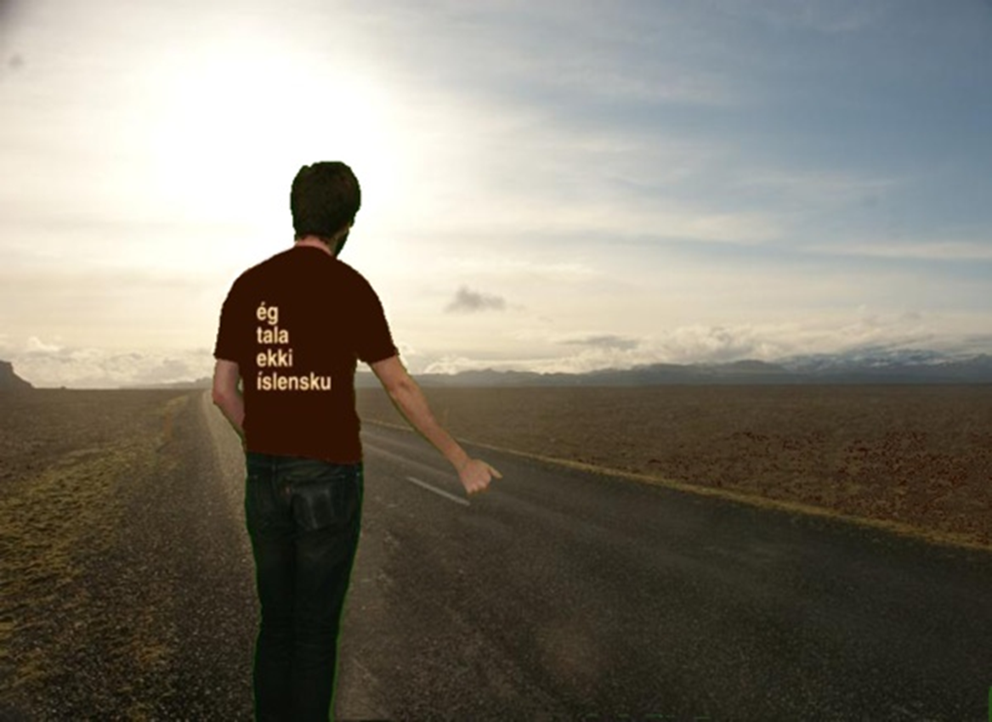
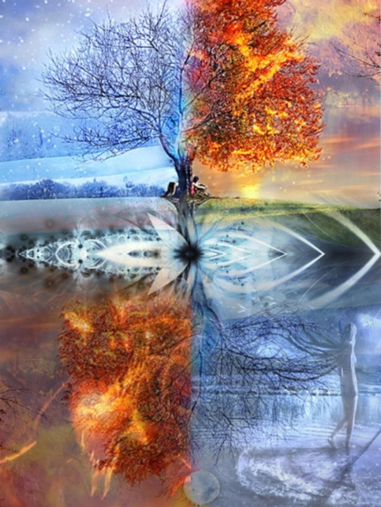
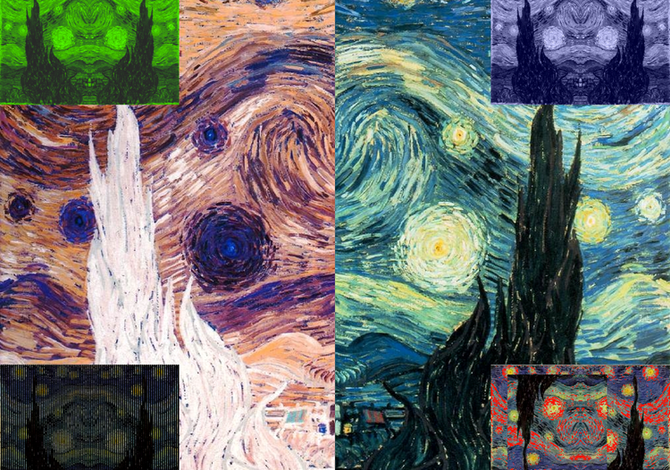
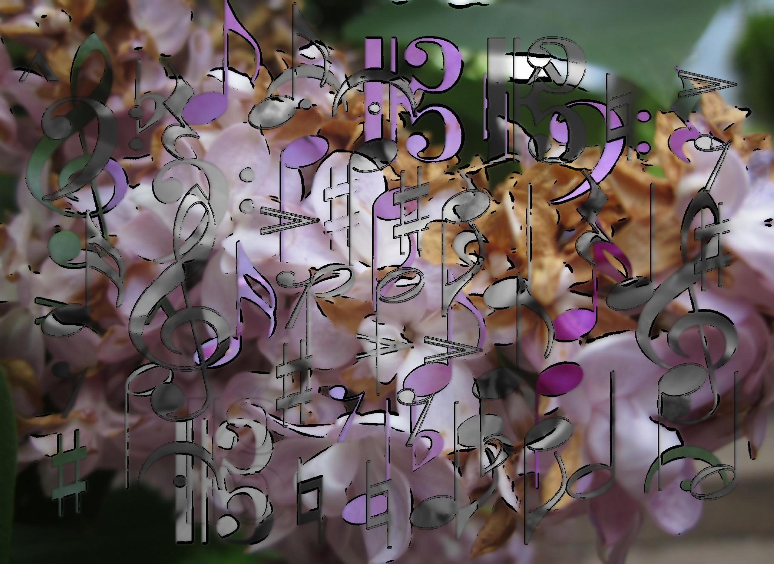
Project 2 – Some examples--- but be creative!
Notes:
Past students created these!

Slide 7
Learning Goals for Today
By the end of today’s lecture, you should be able to:
Read and modify basic Python code that manipulates images using the Pillow (PIL) library

Slide 8
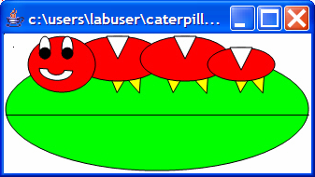
What is a Picture?

Slide 9
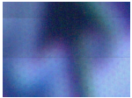
Digitizing pictures as bunches of little dots
We digitize pictures into lots of little dots
Enough dots and it looks like a continuous whole to our eye
Our eye has limited resolution
Our background/depth acuity is particularly low
Each picture element is referred to as a pixel

Slide 10
Images are collections of pixels
Notes:
Birds and butterflies can see ultraviolet. Mantis shrimp are believed to have 16 different color based photoreceptors (but unlikely to process it like we do)

Slide 11
Common Colors
Color | Red | Green | Blue
White | 255 | 255 | 255
Black | 0 | 0 | 0
Red | 255 | 0 | 0
Green | 0 | 255 | 0
Blue | 0 | 0 | 255
Yellow | 255 | 255 | 0
Magenta | 255 | 0 | 255
Cyan | 0 | 255 | 255
Notes:
Birds and butterflies can see ultraviolet. Mantis shrimp are believed to have 16 different color based photoreceptors (but unlikely to process it like we do)

Slide 12
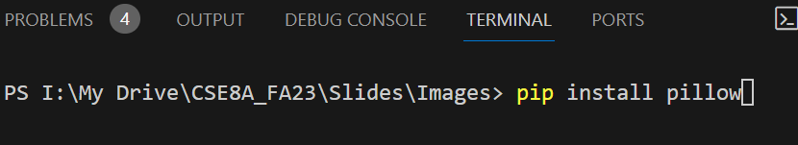
Pillow* – the image processing library for Python
Needs to be installed. Install by going to terminal and run:
pip install pillow
OR
pip3 install pillow
* Was PIL for Python 2. Pillow is the new version of PIL.
Notes:
Just briefly mention that PIL is out of date, it’s been replaced by Pillow, but the library is still PIL. I’ll use them interchangeably when I talk.

Slide 13
Pixels in an Image (using PIL)
An image is an object which contains a 2-dimensional array of (Red, Green, Blue) values
Each Pixel in the Picture is at a particular coordinate, with x==0, y==0 at the upper-left-hand corner of the picture
x y
x y
(4, 0)
(0, 0)
x y
image
(2, 5)

Slide 14
Opening and Displaying Images
Image.open(<path>) - returns a reference to the image in the file
<img>.show() – displays the image
from PIL import Image
# Open an image file
img = Image.open('beach.jpg’)
# Display the image
img.show()
Notes:
Image.open is a function in the Image library
Show is a _method_ on an image object. Remind students about methods vs. functions

Slide 15
Creating a New Image
Image.new(<format>, <tuple of width,height>) - returns a reference to a new image of that type and size. We’ll be using ‘RGB’
from PIL import Image
width = 10
height = 20
img = Image.new('RGB', (width, height))
# Display the image
img.show()
Notes:
Point out RGB is the format, width and height are a tuple!

Slide 16
What is the image?
2-dimensional array of tuples
This image has a width of 3 and a height of 6
It has a row of white, a row of red, a row of black, and so forth
(255,255,255) | (255,255,255) | (255,255,255)
(255,0,0) | (255,0,0) | (255,0,0)
(0,0,0) | (0,0,0) | (0,0,0)
(255,255,255) | (255,255,255) | (255,255,255)
(255,0,0) | (255,0,0) | (255,0,0)
(0,0,0) | (0,0,0) | (0,0,0)

Slide 17
Accessing a Picture’s height and width
<img>.size() returns a tuple of the width/height of the <img>
from PIL import Image
width = 10
height = 20
img = Image.new('RGB', (width, height))
# Display the image
print(img.size)
(10, 20)
width, height = img.size
Notes:
Size is a tuple, as we’d expect. Often we can assign it like this. ***

Slide 18
Accessing and Changing Pixels
<img>.getpixel(x,y) – returns the (r,g,b) tuple at the x,y location in the image.
<img>.putpixel((x,y,), (r,g,b)) - changes the pixel at the location in the tuple (x,y) to the color values specified in the tuple of ints (r,g,b)
from PIL import Image
img = Image.open('beach.jpg')
r,g,b = img.getpixel(0,0)
img.putpixel((0,0),(0,g,b))
Notes:
Getpixel and putpixel are methods on an image

Slide 19
Accessing and Changing Pixels
from PIL import Image
img = Image.open('beach.jpg')
r,g,b = img.getpixel(0,0)
img.putpixel((0,0),(0,g,b))
What does this code do?
Makes the pixel at (0,0) black
Removes the red component of the pixel at (0,0)
Makes the entire image black
Removes the red component from the entire image
None of the above
Notes:
Removes the red component for just the pixel at 0,0. Not particularly interesting, but checks to see if they’ve been paying attention.

Slide 20
Saving an Image
<img>.save(<path>) – saves the image in the specified file
from PIL import Image
img = Image.open('beach.jpg')
img.save("new_file.jpg")
Notes:
Save is also a method on an image object

Slide 21
Changing Images
We’ll write a bunch of functions to change images, but they can loosely be categorized as:
Changing pixels based on pixel values
Grayscale, negative, edge detection, etc.
Changing pixels based on their location
Drawing shapes, modifying parts of images, rotating, mirroring, etc.
Changing pixels based on a combination of values and locations
Red eye reduction, blemish removal, etc.
Combining multiple images
Collages, green screen substitution, blending
Notes:
Talk this through! We’ll reiterate this later when talking about what our expectations are for them.

Slide 22
What does this function do?
def mystery(image):
width, height = image.size
for x in range(width):
for y in range(height):
r, g, b = image.getpixel((x,y))
image.putpixel((x,y), (r, b, g))
Does not change the image
Swaps the green and blue components of each pixel in the image
Makes the entire image black
Removes the red component from the entire image
None of the above
Notes:
Swaps the green and blue channels

Slide 23
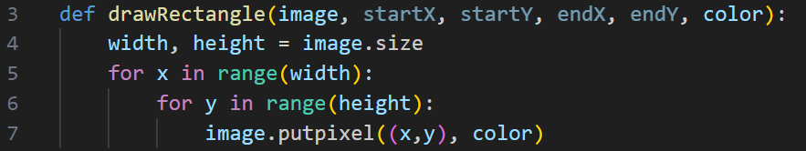


Buggy Draw Rectangle
original
result
img = Image.new('RGB', (600, 400),(255,255,255))
img.show()
drawRectangle(img, 100, 100, 200, 200, (255,0,0))
img.show()
What line(s) of code do we need to fix?
Line 7
Lines 3 and 7
Lines 5 and 6
Line 4
Notes:
Lines 5 and 6 need to be updated to use the startX, startY, endX, endY
Original code:
def drawRectangle(image, startX, startY, endX, endY, color):
width, height = image.size
for x in range(width):
for y in range(height):
image.putpixel((x,y), color)
Desired:
def drawRectangle(image, startX, startY, endX, endY, color):
width, height = image.size
for x in range(startX, endX):
for y in range(startY, endY):
image.putpixel((x,y), color)

Slide 24
Write a grayscale function (together)
Let’s write this in steps:
Make the image (parameter) grayscale
Don’t change the parameter image. Instead, make a new image that is a copy of the original, make it grayscale, and return it
Make just a region of the picture grayscale
Handle user errors with bad coordinates
Notes:
When we do step 3, be sure to point out that we’re solving this silently
Live Coding: Goal will be to build this:
def grayscale(image, startX, startY, endX, endY):
result = image.copy()
width, height = result.size
for x in range(max(0,startX), min(endX,width)):
for y in range(max(0, startY), min(height, endY)):
r, g, b = result.getpixel((x,y))
gray = int((r + b + g) / 3)
result.putpixel((x,y), (gray, gray, gray))
return result

Slide 25
Why is the final version of grayscale better?
We often want to avoid changing the source image. However, this might be debatable as this function uses more space/memory.
Allowing the user to specify the range makes the function more versatile
Adding protection against “user” (user of the function) error avoids walking off the end of the image
Notes:
Talk about the protection really being a way to fail silently, but there are better ways to fail (exceptions) that they’ll learn about in later clases.

Slide 26
Summary
The Pillow (PIL) library offers useful functions for working with images
We can manipulate images in a variety of ways
Today we did basic operations like grayscale and drawing rectangles, we’ll grow the complexity in the next few classes

